Slide 1



PMO Web App Execution Phase Presentation
Submitted By: Team Paris
Kiran (Project Manager)
Simranjit Singh (PCO)
Ashu Gupta (Business Analyst)
Mansi Thakkar (Developer)
Manvi Gupta (Tester)
Guests:
Kadidia Fofana (Client Representative)
Serge Niagne (Steering Committee Member)
Vera Fares (Steering Committee Member)

Slide 2

Agenda
Project Scope
Timeline Review
Budget Review
Risk and Issues
Design Consideration
System Architect
Application Overview
Gating System
Prototype Drafts
Lesson Learned
Conclusion

Slide 3
Project Scope
A web application to be made which monitors all the projects in an AI & robotics company, ABC TECH whose sales have increased since past 2 years and is lacking a co-ordination in its PMO department.
To monitor all the projects and to implement the gating systems as per audit standards.

Slide 4

Timeline Overview
Project charter-08/07/2020
Business requirement document-22/07/2020
Procurement-04/08/2020
Project plan management-05/08/2020
Design: 12/08/2020
Development: 22/08/2020
Testing: 02/08/2020

Slide 5
Upcoming Tasks
Deployment- 03/09/2020
Training- 07/09/2020
Go Live- 08/09/2020

Slide 6
Budget Review
Planned Budget:
$73511/-CAD
Revised Planned Budget:
(After change request)
$81351/-CAD
Actual Cost:
$81351/-CAD

Slide 7
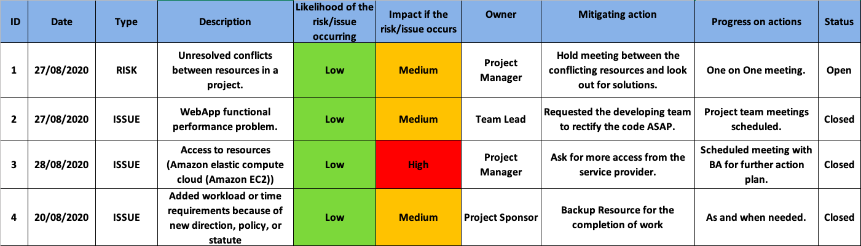
Risks and Issues

Slide 8

Design Methodology
Platform:
AWS Cloud
Application Language:
Backend: JAVA
Frontend: HTML
Methodology :
Agile and Waterfall

Slide 9
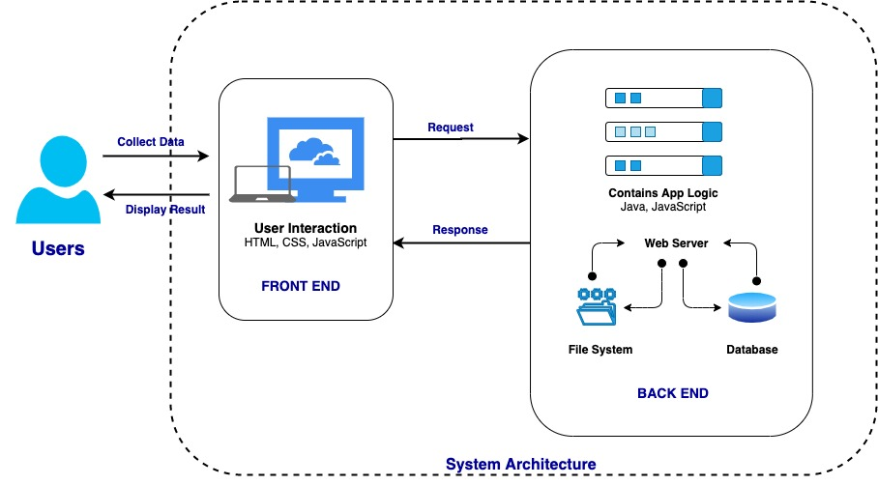
System Architect

Slide 10
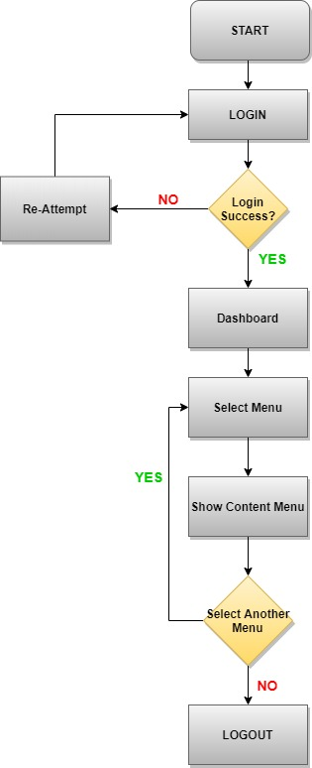
Application Flowchart

Slide 11
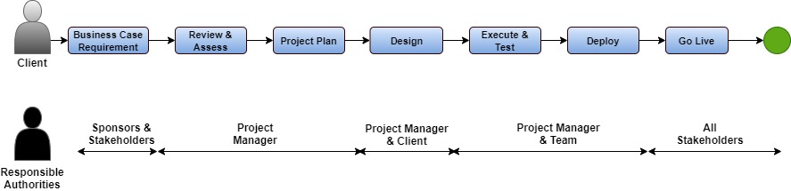
Approval Gating System

Slide 12
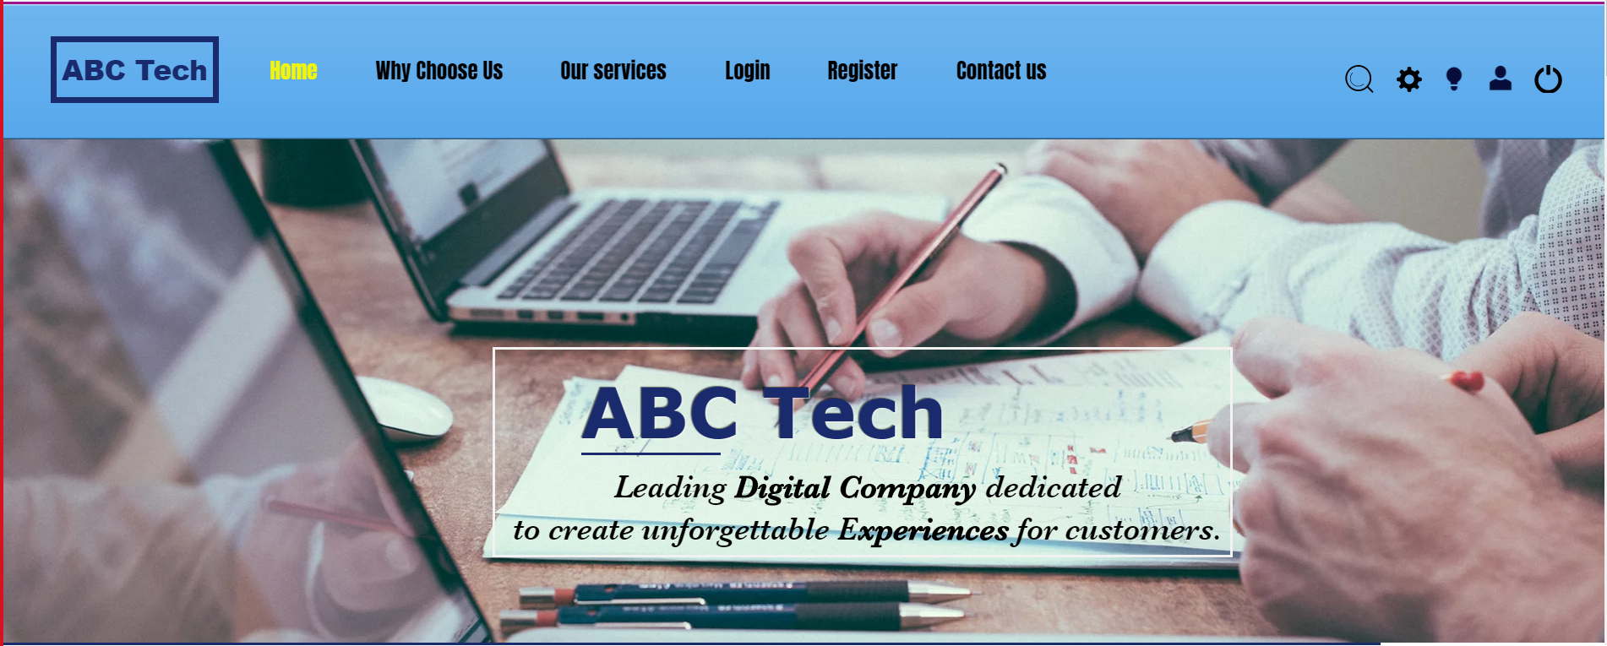
Home Page
Integrate Login system directly with ABC Tech Website. Therefore, it will be easy for the employees to access the application.

Slide 13
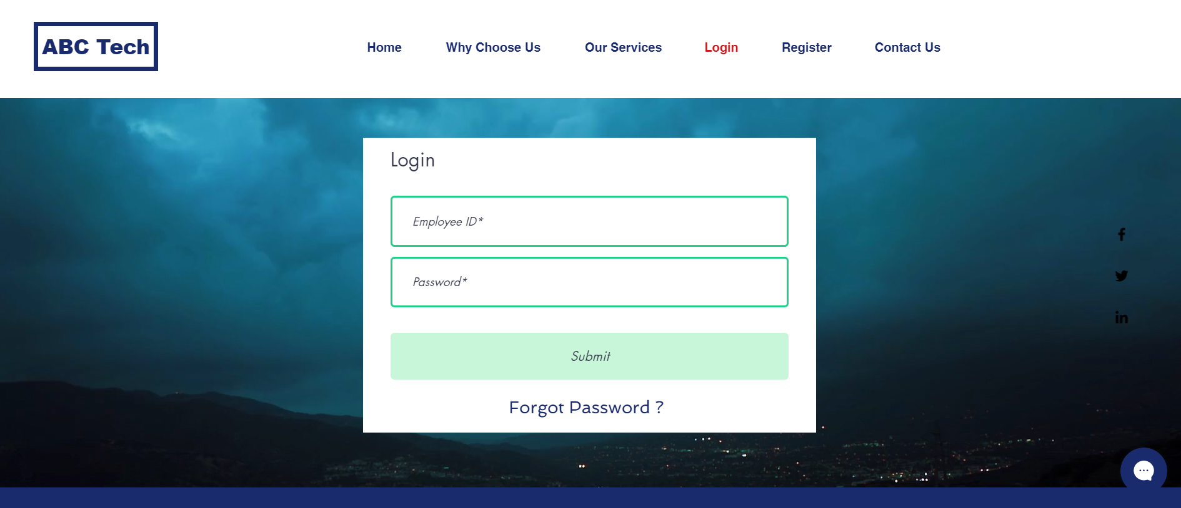
Prototype Login Page

Slide 14
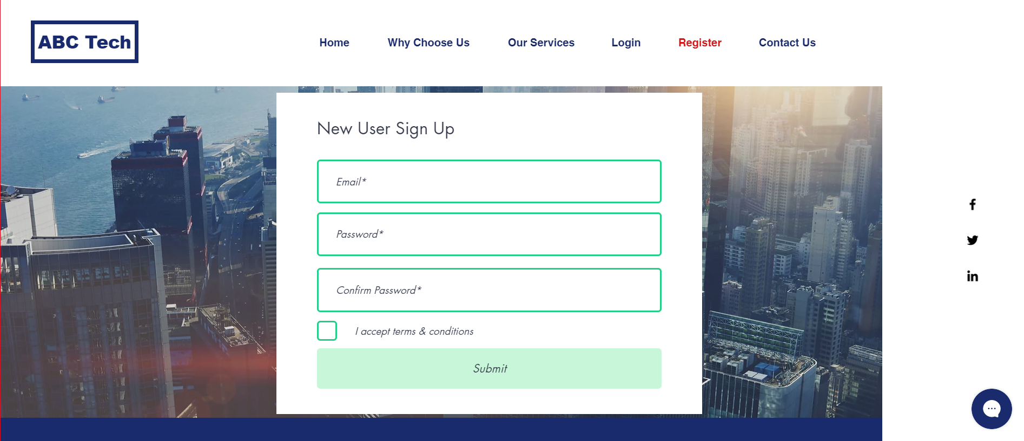
Registration Page

Slide 15
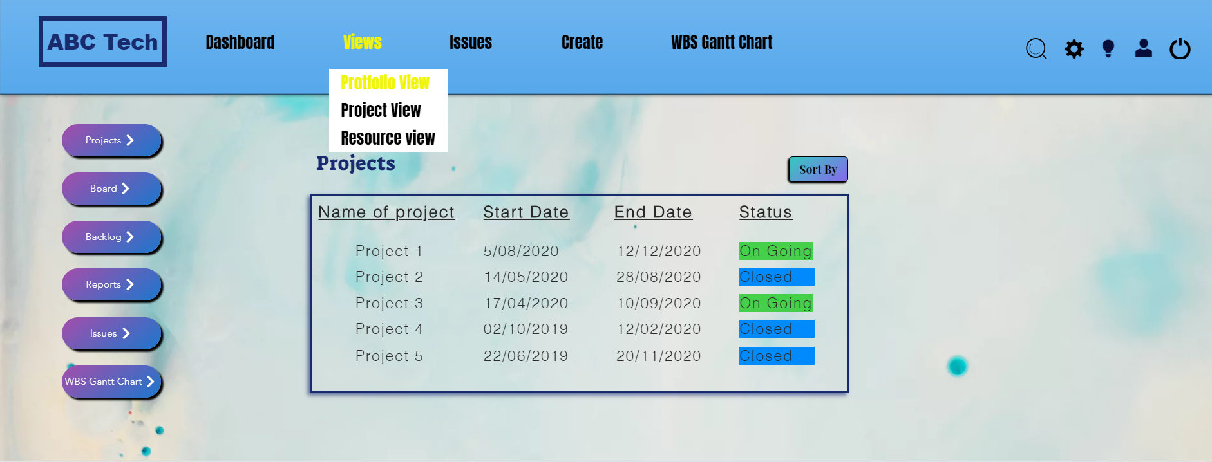
Portfolio View

Slide 16
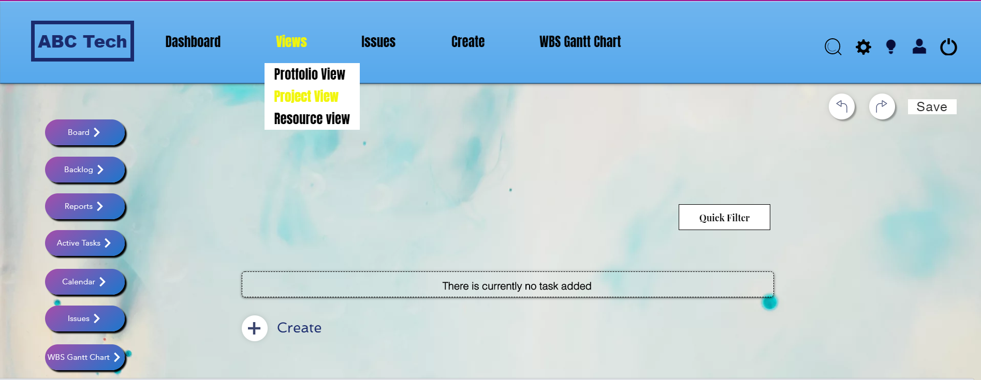
Project View

Slide 17
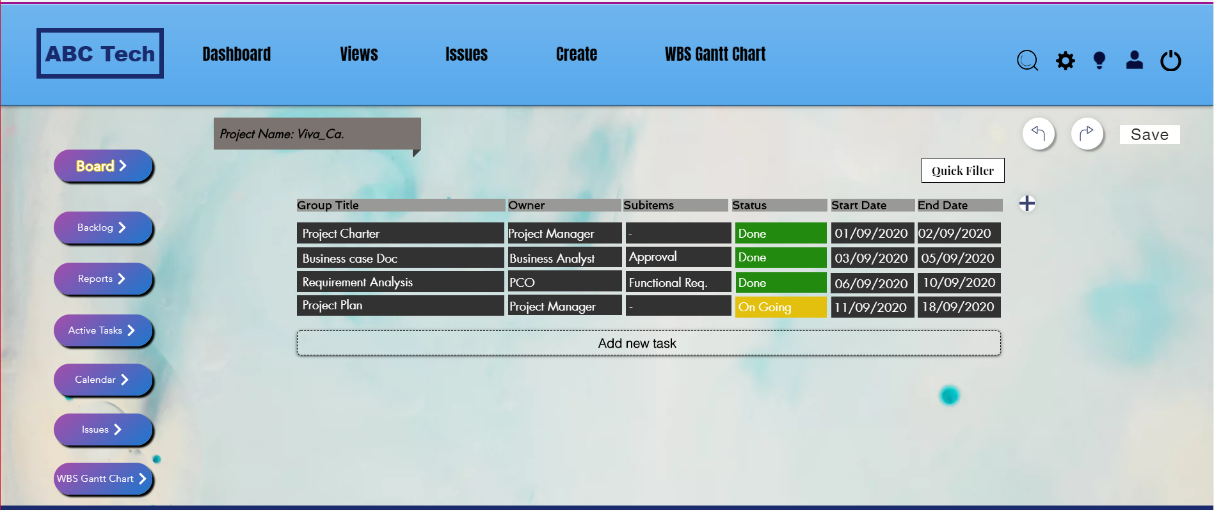
Project View

Slide 18
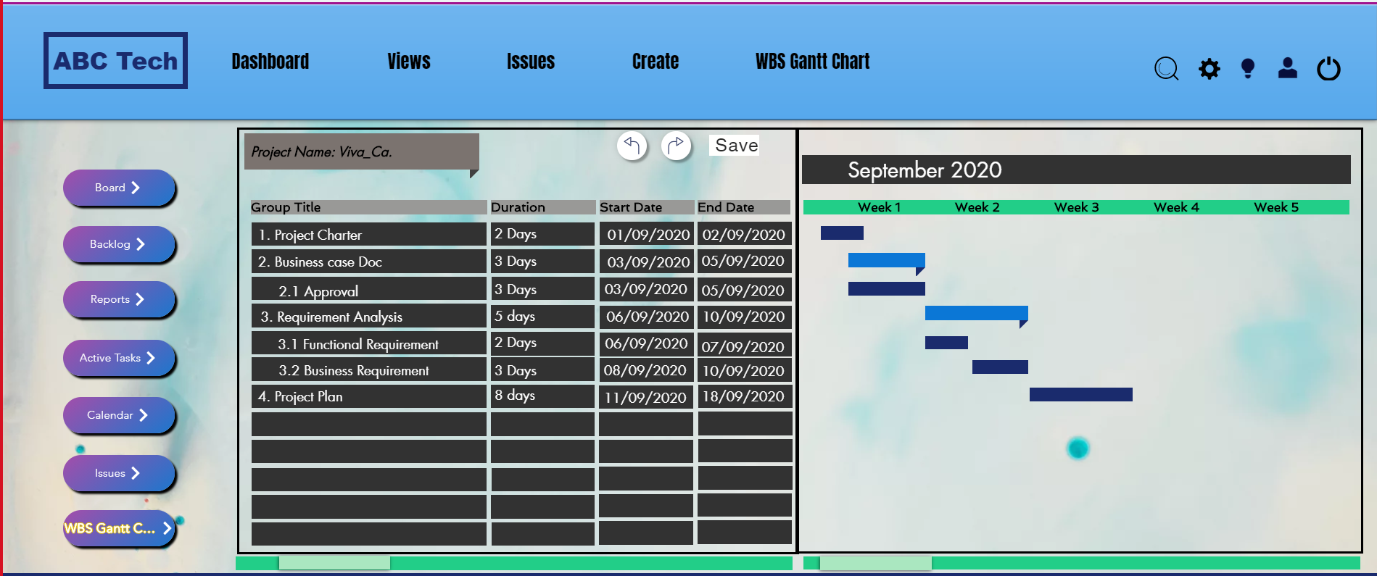
Project View

Slide 19
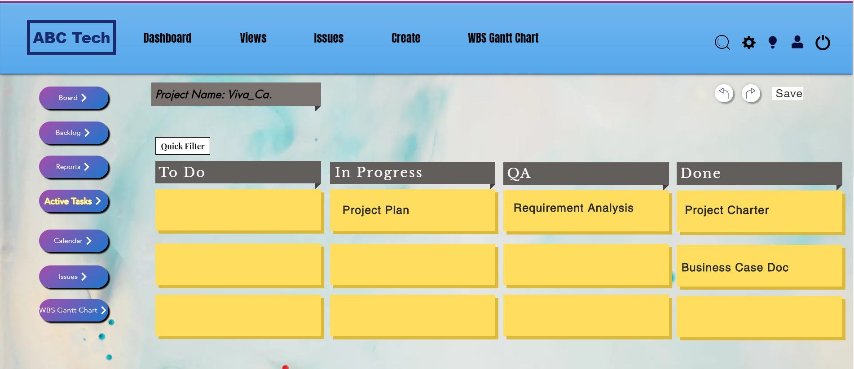
Project View

Slide 20
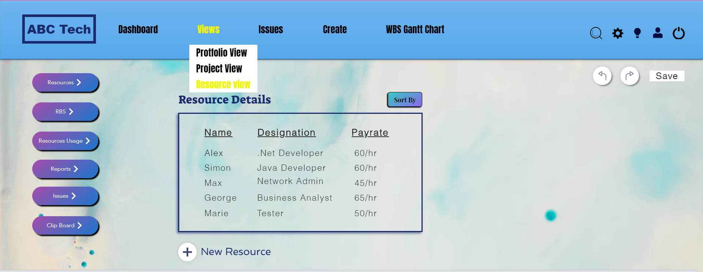
Resource View

Slide 21
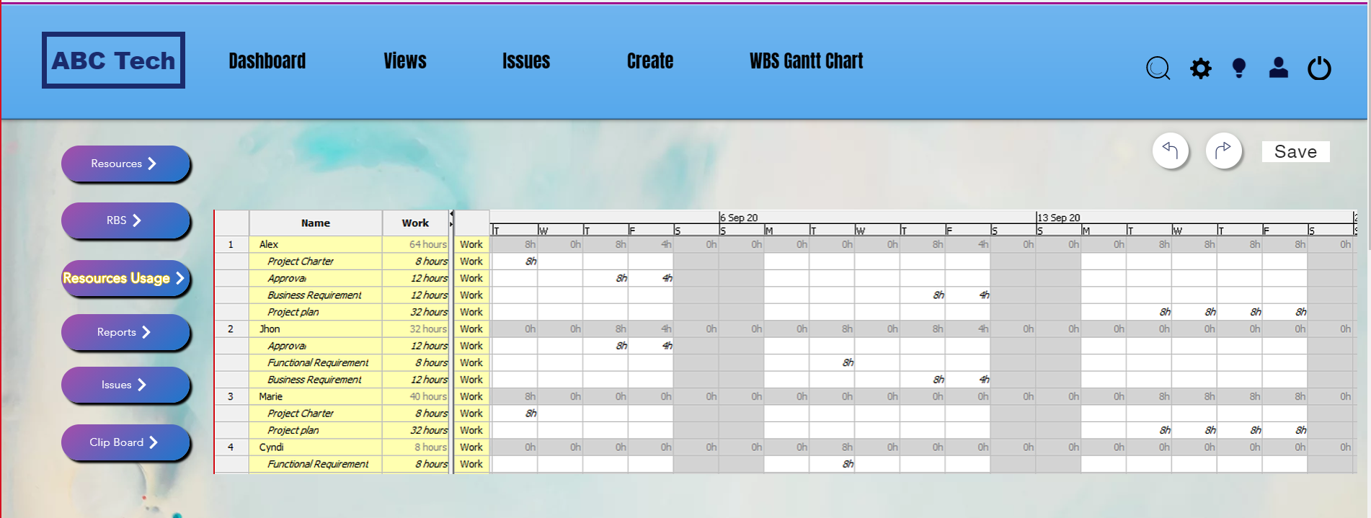
Resource View

Slide 22
Conclusion
To conclude with the PMO Web App with all the major functions has been developed with the specifications given by the client.
Platform:
AWS Cloud
Application Language:
Backend: JAVA
Frontend: HTML
Budget:
Total cost: $ 100000/- CAD
Used cost: $ 81351/- CAD
Timeline:
Time: 10 weeks

Slide 23
Lessons Learned
Communication: Remotely working with Project sponsors as well as with Team Members
Teamwork: Learnt how to deal with types of situations.
Design document: Working on different documents.
Data flow: How to integrate different modules of the application.
Software: Hands on experience on different types of software’s.
Change Request: How to cope up with sudden change request.

Slide 24

Thank You

Slide 25

Any Questions?

